Slide 1
Power consumption analysis and Time series forecasting
GEOG582 Final Project
Chandra Teja Peddi (Big Data Analytics)

Slide 2
Motivation
The electricity consumption being so crucial to any countries development, I plan to analyze the impact on energy consumption state and region wise in India.

Slide 3
Goals
To analyze the power consumption in different states of India for a period of 17 months using different visualizations.
To try and forecast the near future using Prophet library.

Slide 4
The Data
2 datasets
The first dataset contains India states as shape file.
The second is in the form of a time series for a period of 17 months beginning from 2nd Jan 2019 till 23rd May 2020.
Rows are indexed with dates and columns represent states.
Rows and columns put together, each datapoint reflects the power consumed in Mega Units (MU) by the given state (column) at the given date (row).

Slide 5
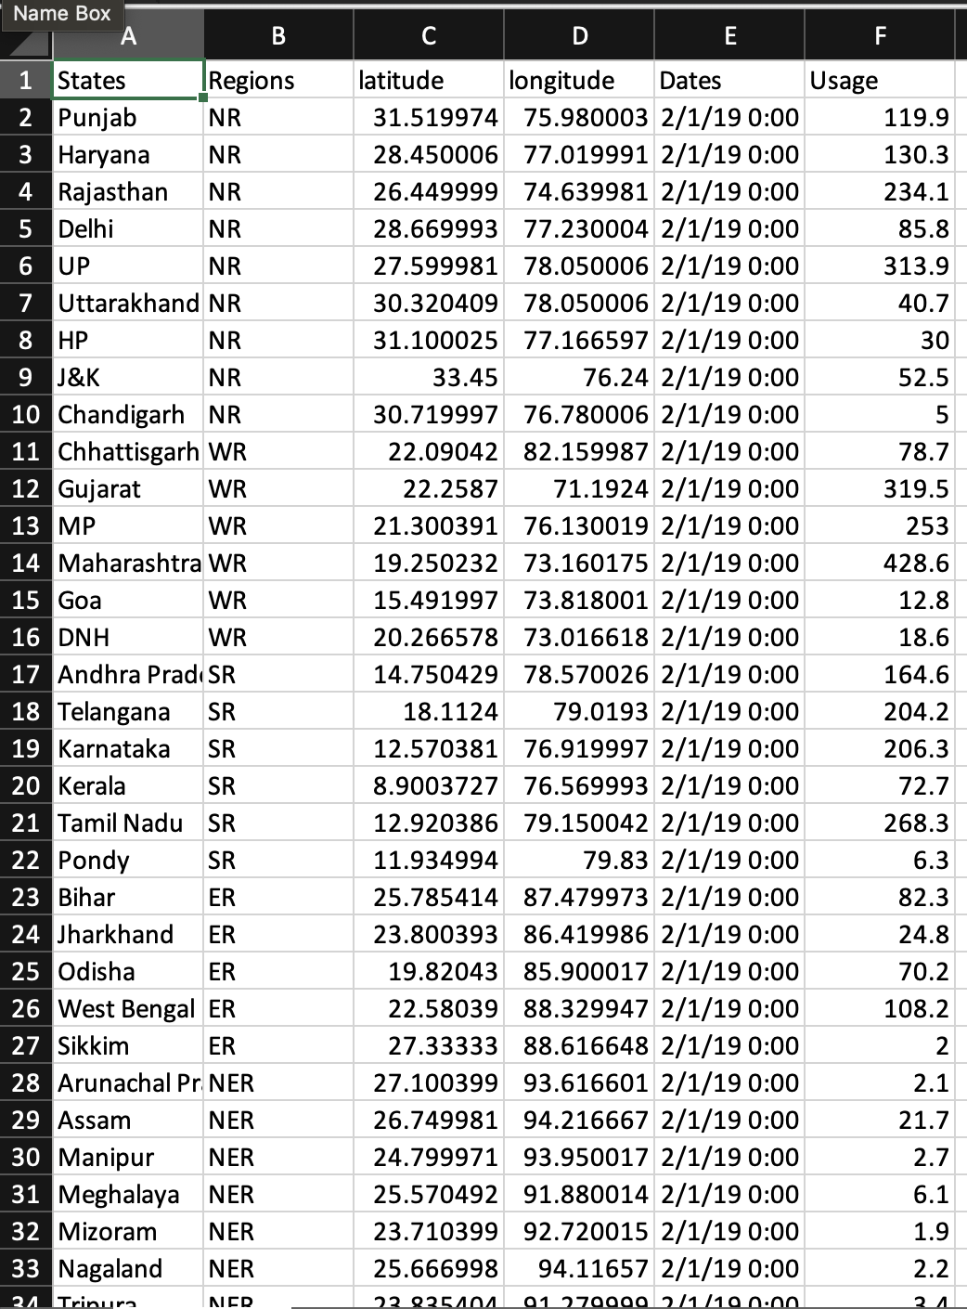

Slide 6
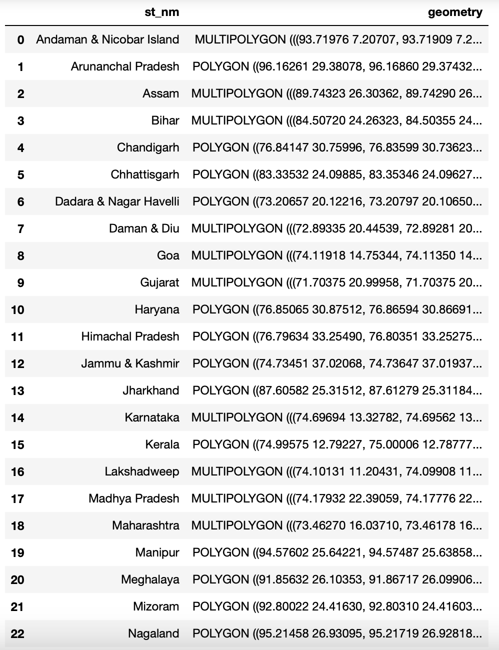

Slide 7
Libraries used
pandas
matplotlib
geopandas
seaborn
sklearn
plotly
prophet
requests

Slide 8
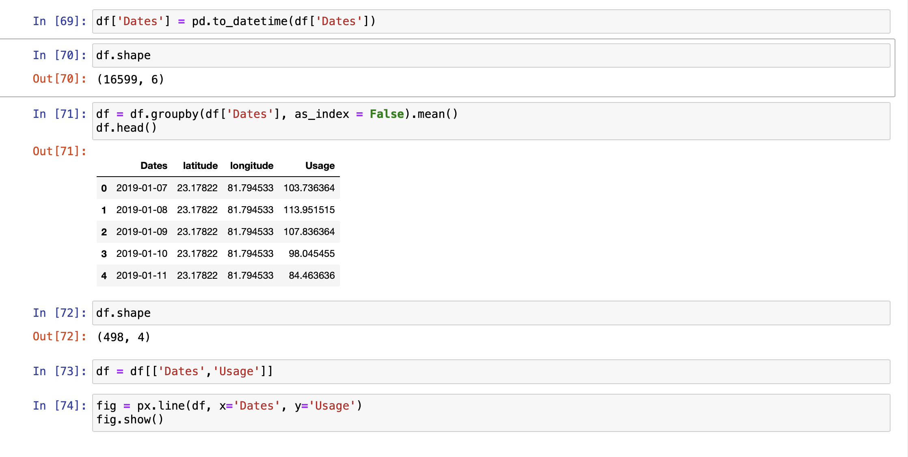

Slide 9
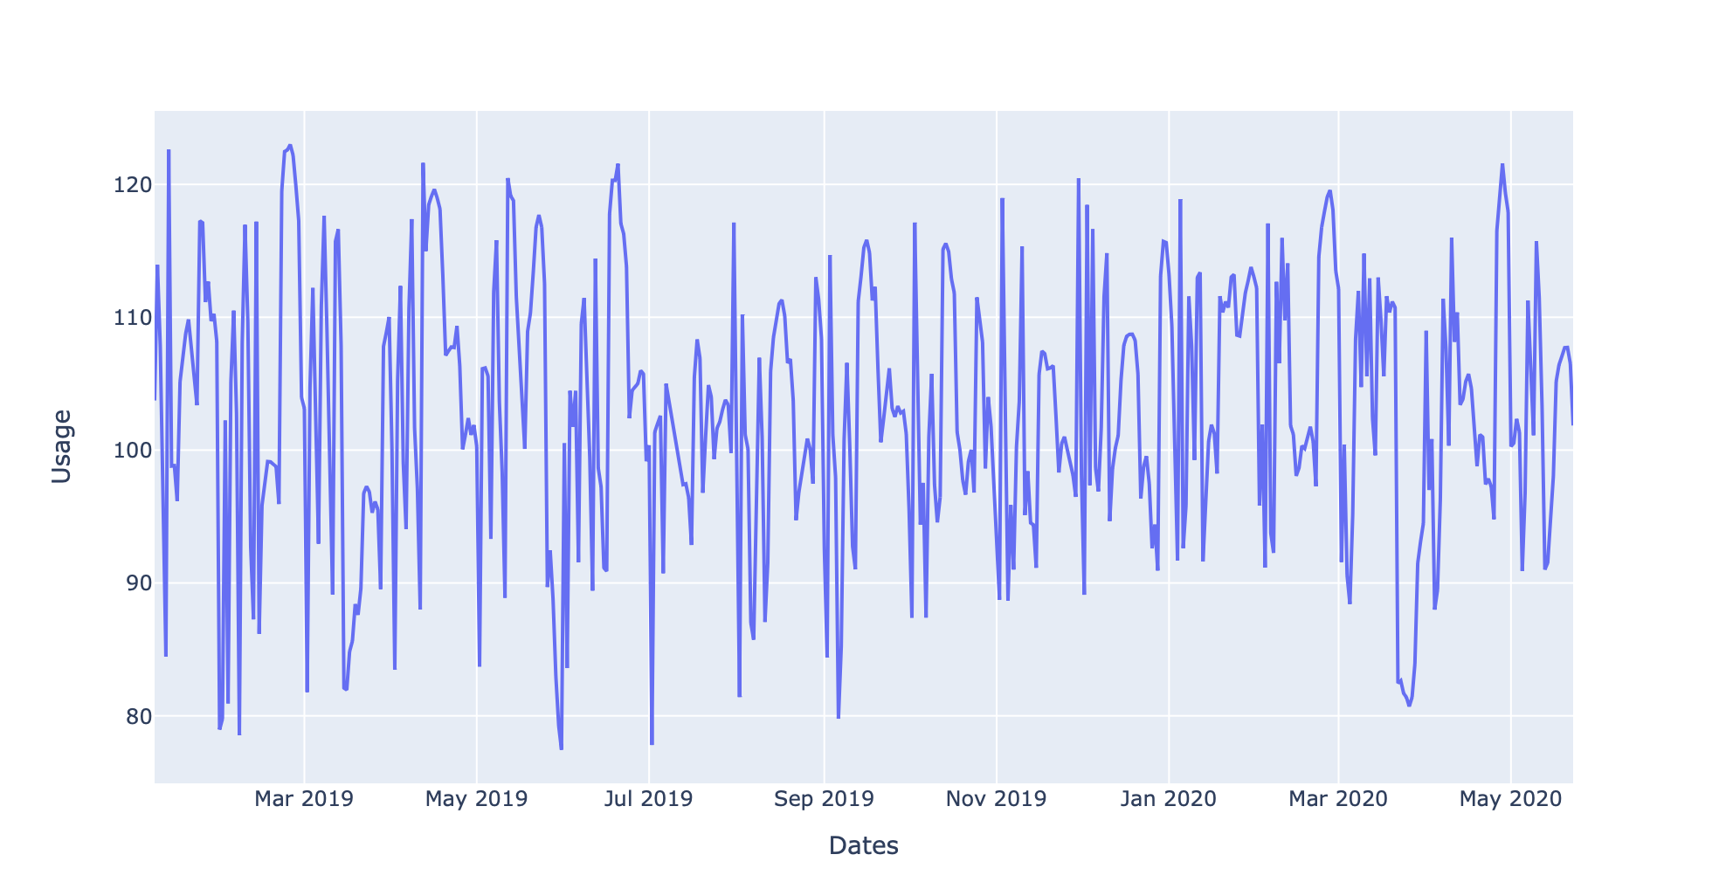
Average power consumption of India

Slide 10
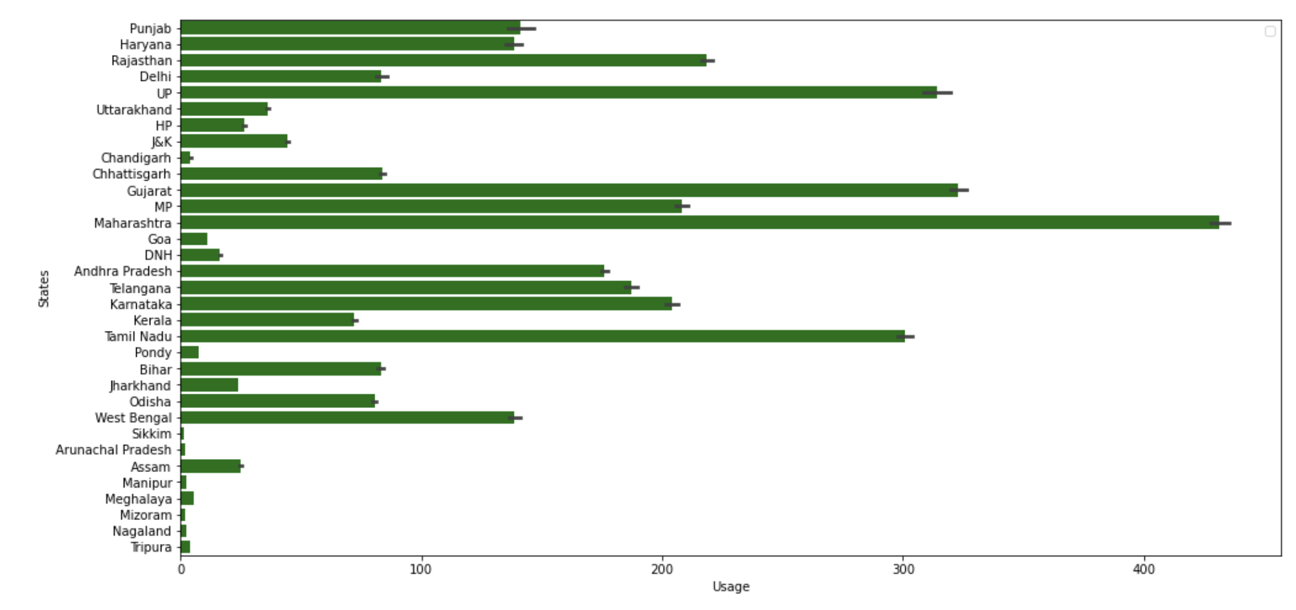
State-wise average usage

Slide 11
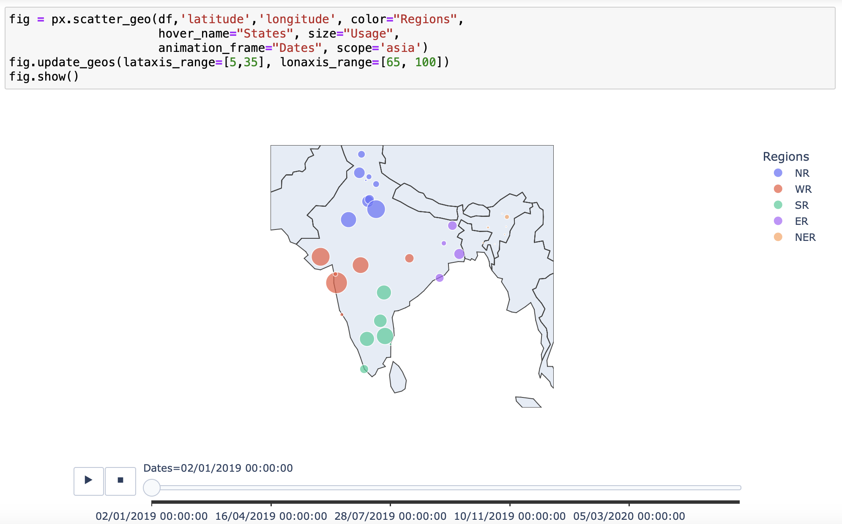
Region wise power consumption throughout India

Slide 12
Task 1
Scrape wikipedia page to get the State-wise per-capita power consumption table and visualize

Slide 13
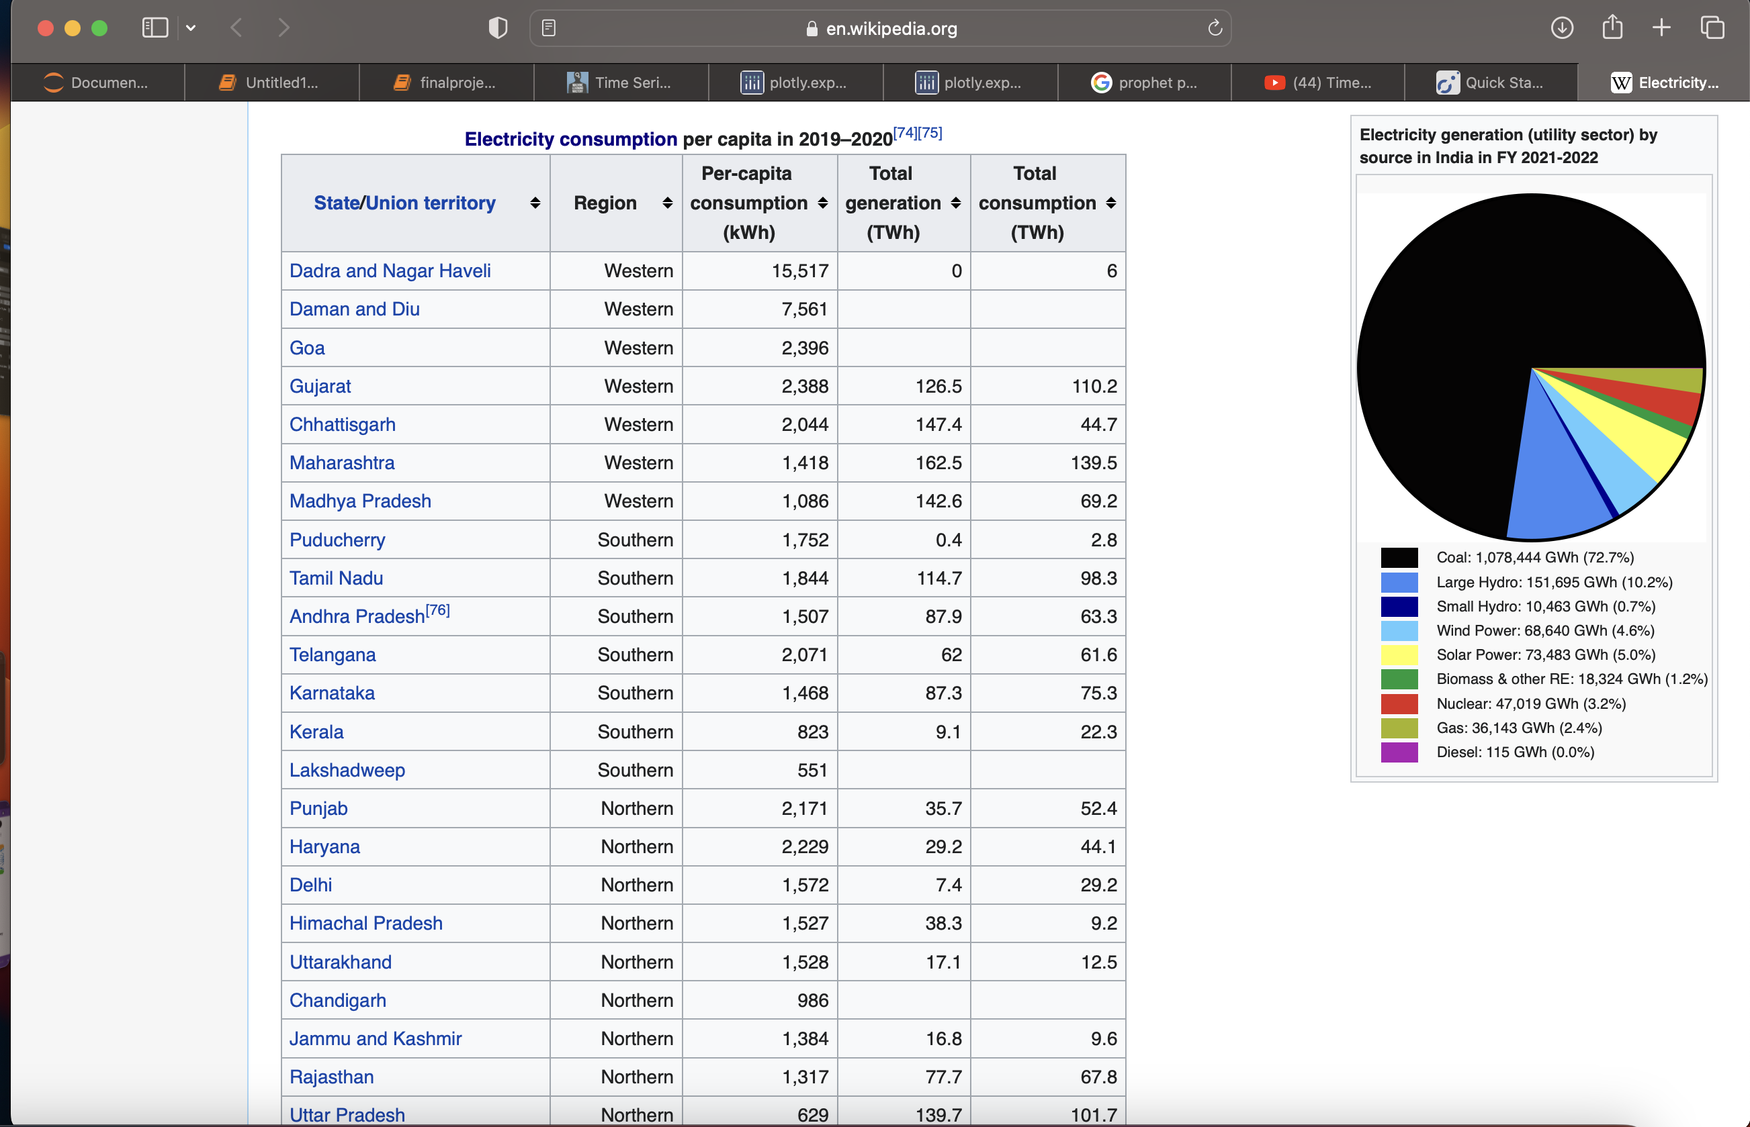

Slide 14
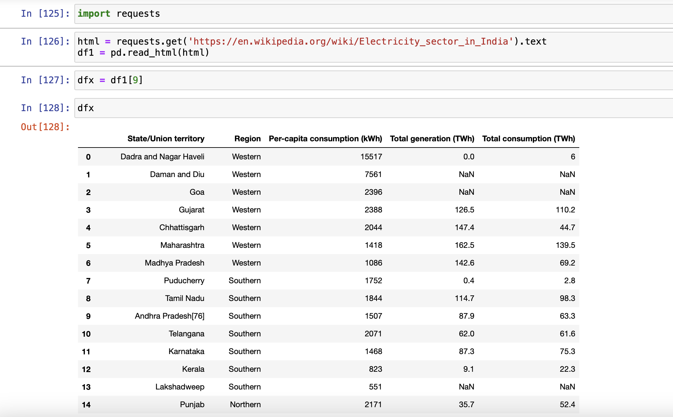

Slide 15
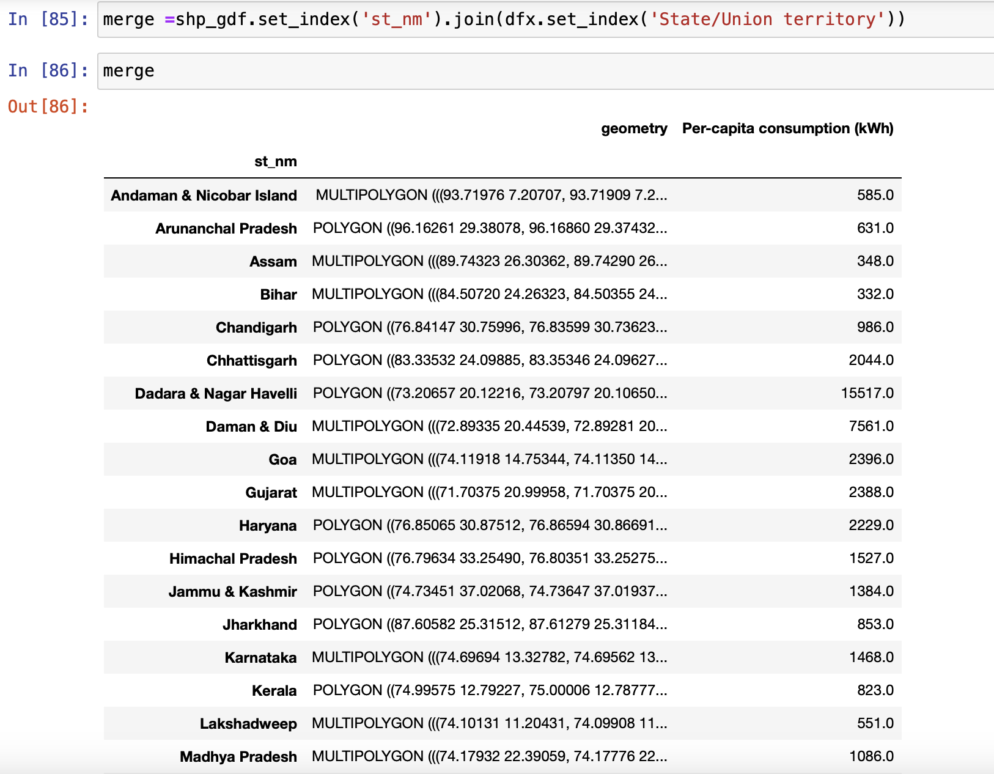
Renamed the state names to match with the shape file data.
Dropped some irrelevant columns.
Merged both data frames by state name.

Slide 16
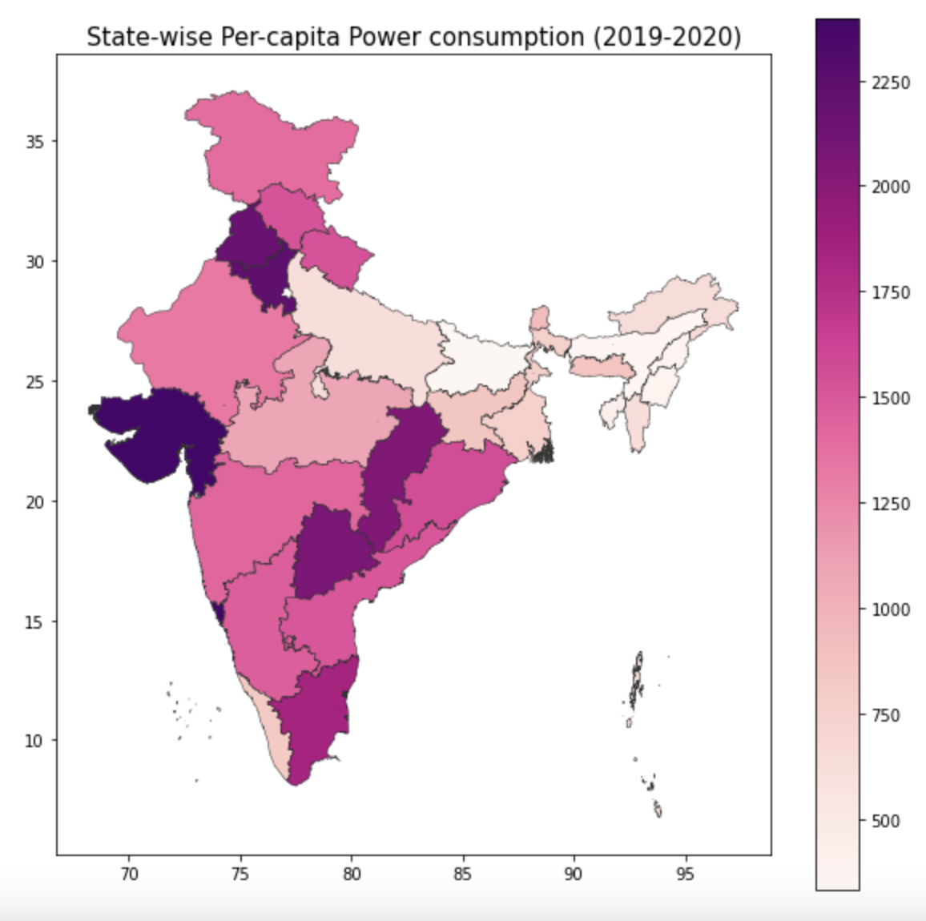

Slide 17
Task 2
Time series forecasting using Prophet

Slide 18
How Prophet works?
We fit the model by instantiating a new Prophet object. Any settings to the forecasting procedure are passed into the constructor. Then you call its fit method and pass in the dataframe.
Predictions are then made on a dataframe with a column ds containing the dates for which a prediction is to be made. You can get a suitable dataframe that extends into the future a specified number of days using the helper method Prophet.make_future_dataframe.

Slide 19
How Prophet works?
The predict method will assign each row in future a predicted value which it names yhat.
The forecast object here is a new dataframe that includes a column yhat with the forecast, as well as columns for components and uncertainty intervals.
We can plot the forecast by calling the Prophet.plot method and passing in the forecast dataframe.

Slide 20
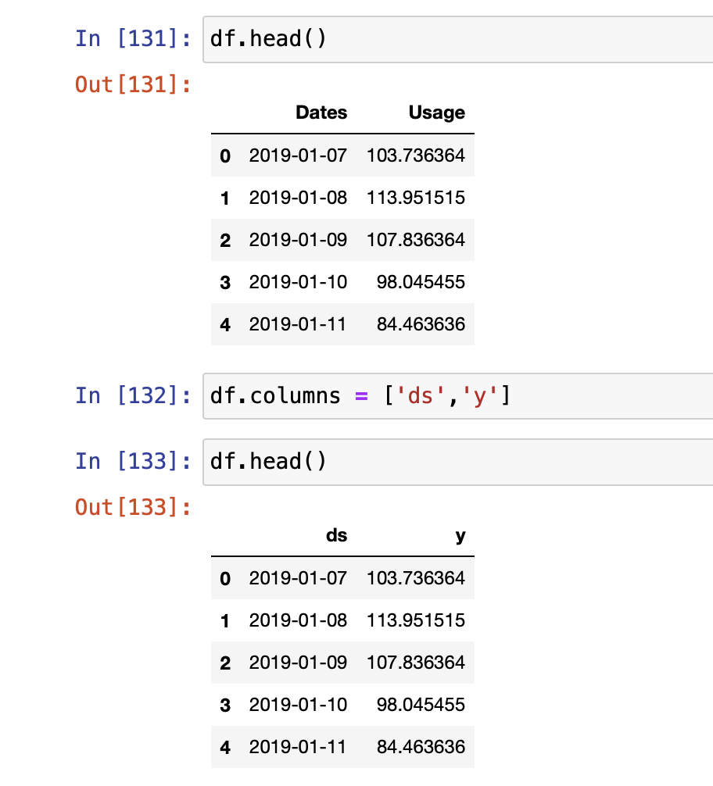
Changing the data frame to comply with Prophet format.
ds is datestamp column and should be as per pandas datatime format.
y is the numeric column we want to predict or forecast.

Slide 21
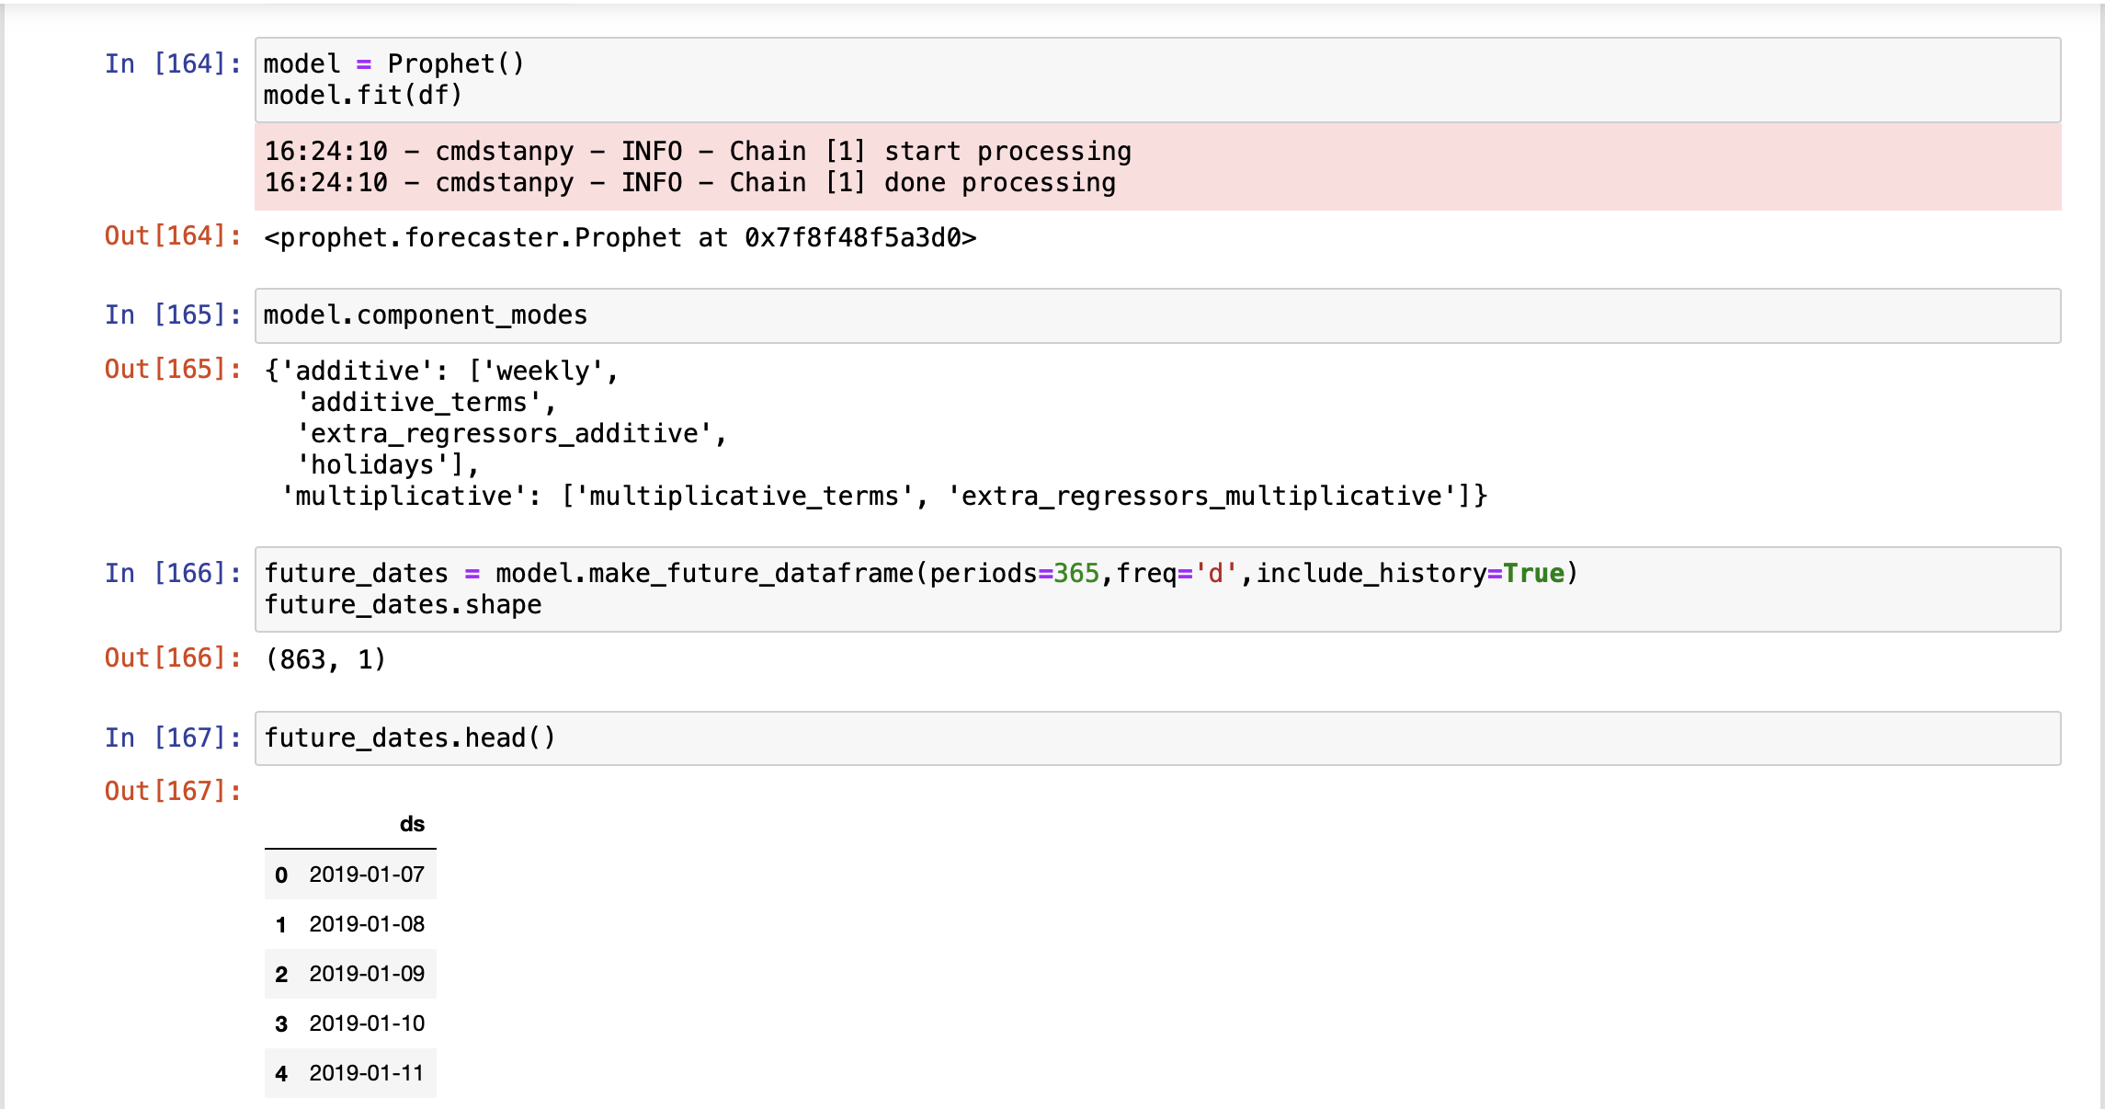

Slide 22
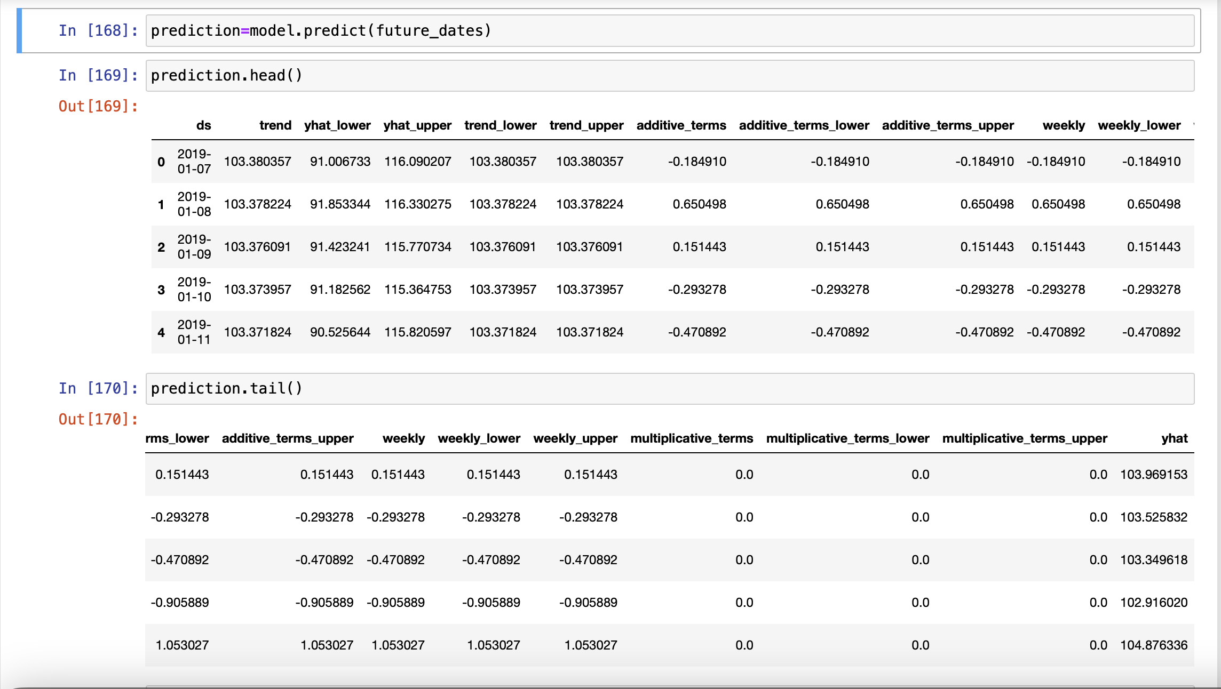

Slide 23
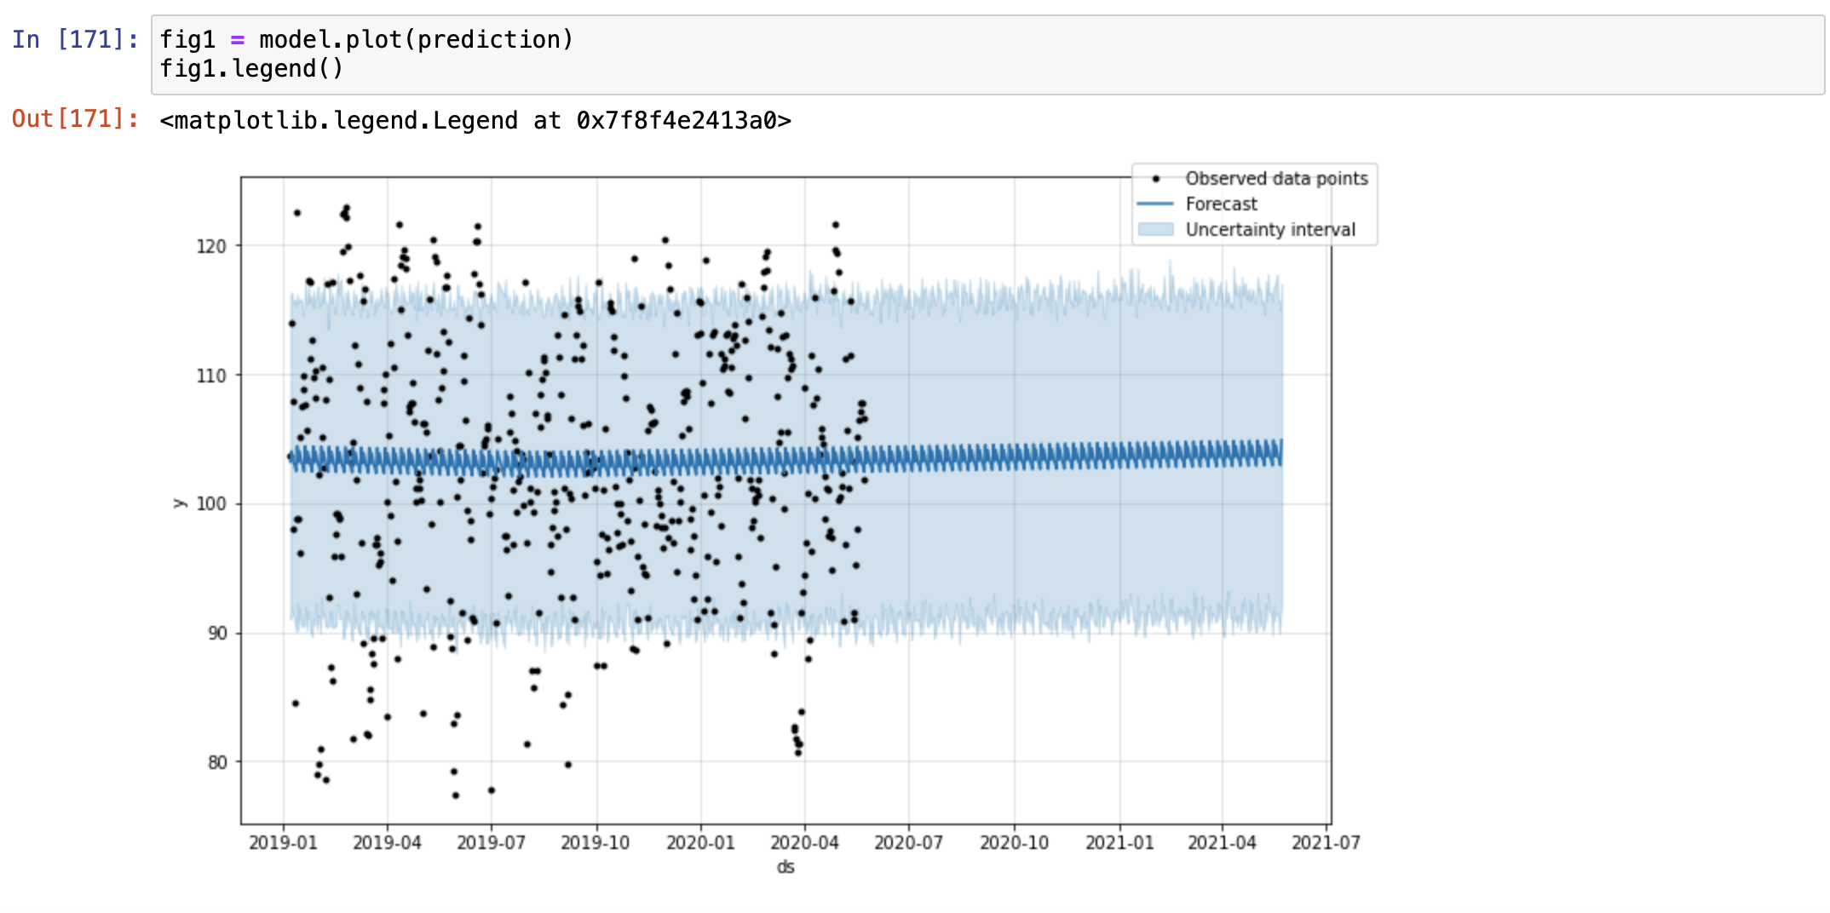

Slide 24
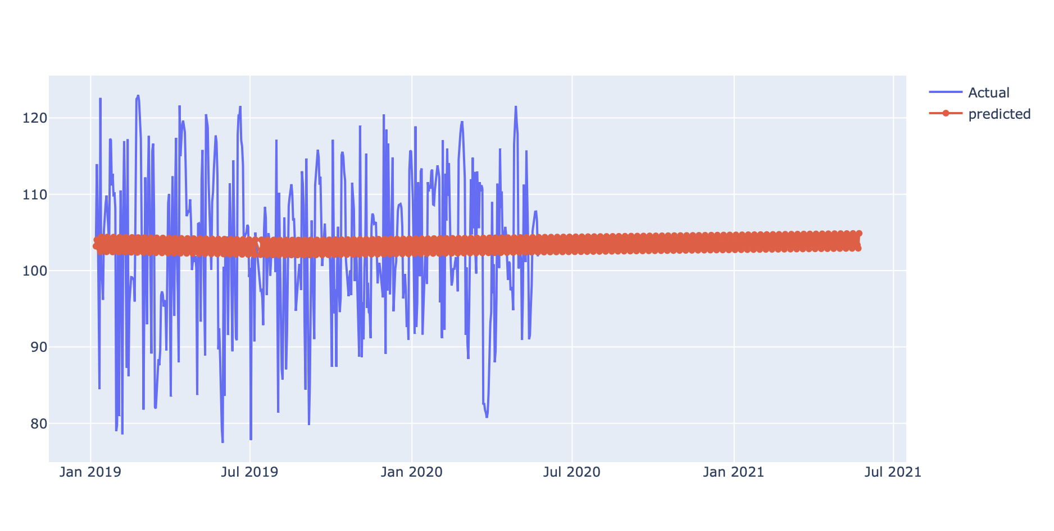

Slide 25
Mean Absolute Error
7.910

Slide 26
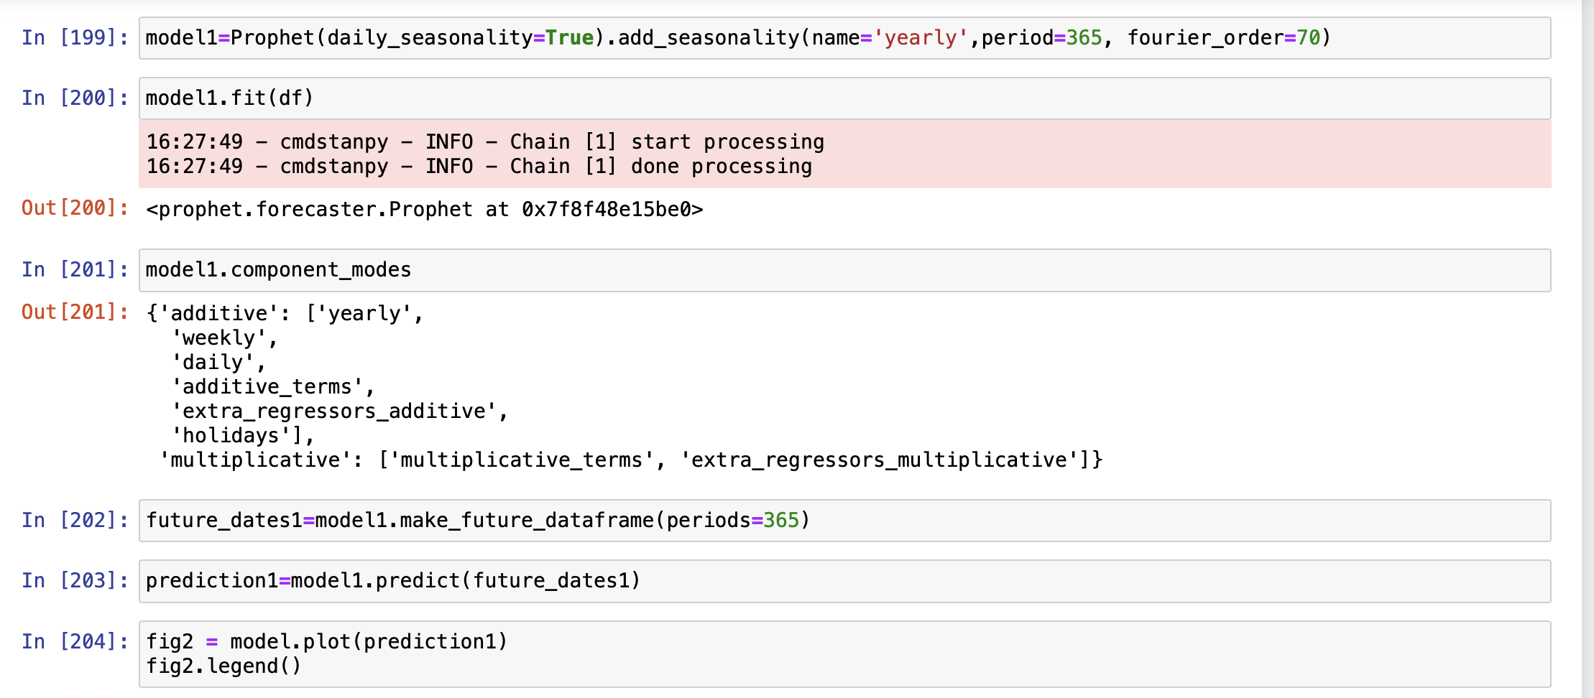
Optimizing

Slide 27
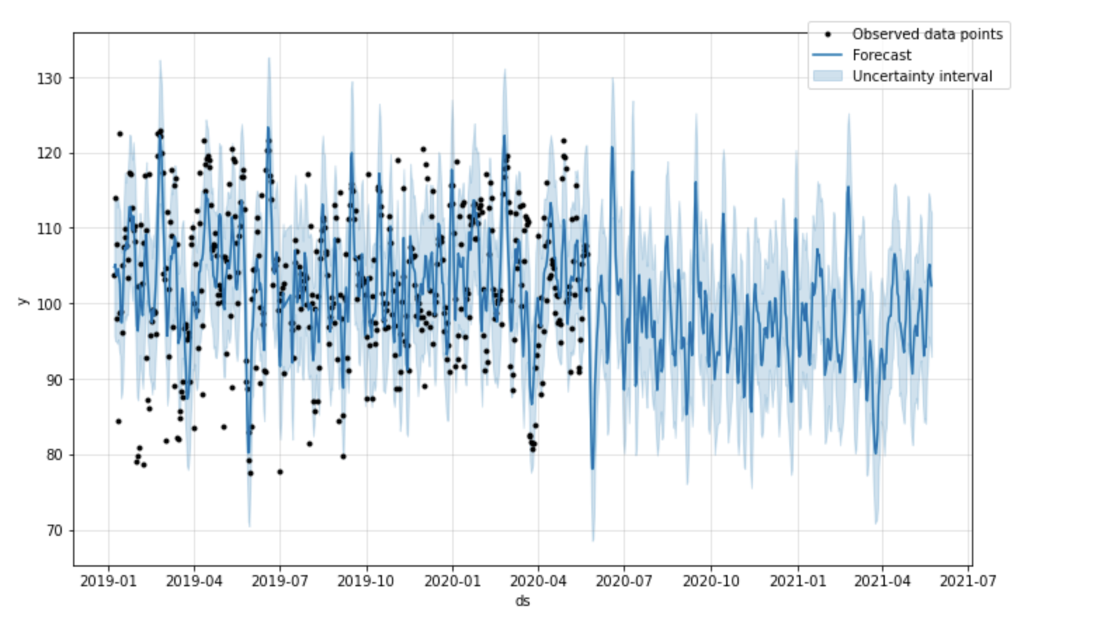

Slide 28
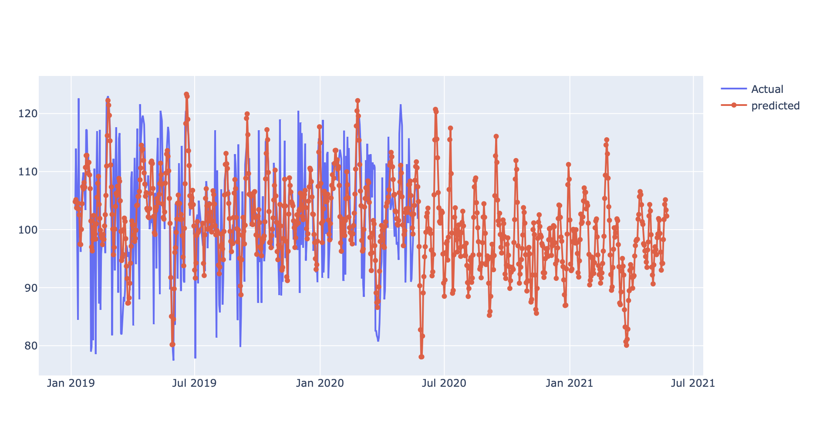

Slide 29
Mean Absolute error
5.600

Slide 30
References
https://plotly.com/python-api-reference/generated/plotly.express.scatter_geo.html
https://www.youtube.com/watch?v=KvLG1uTC-KU
https://facebook.github.io/prophet/docs/quick_start.html
https://en.wikipedia.org/wiki/Electricity_sector_in_India
https://machinelearningmastery.com/time-series-forecasting-with-prophet-in-python/

